Slide 1
NAAN MUDHALVAN PROJECT
•

Slide 2
COLLEGE DETAILS

Slide 3
GOVERNMENT ARTS AND SCIENCE COLLEGE FOR MEN
KRISHNAGIRI-635002 DEPARTMENT OF PHYSICS

Slide 4
PROJECT DETAILS

Slide 5
PROJECT NAME :UNLOCKING INSIGHTS INTO THE GLOBAL AIR TRANSPORTATION NETWORK WITH TABLEAU.
TEAM LEADER
C. SATHISH KUMAR TEAM MEMBERS
N. PAVAN KUMAR
S. KESAVAPERUMAL
S. VICKRAM
GUIDED BY
DR. S. CHINNASMAY M. SC, PHD

Slide 6
EMPATHY MAP

Slide 7
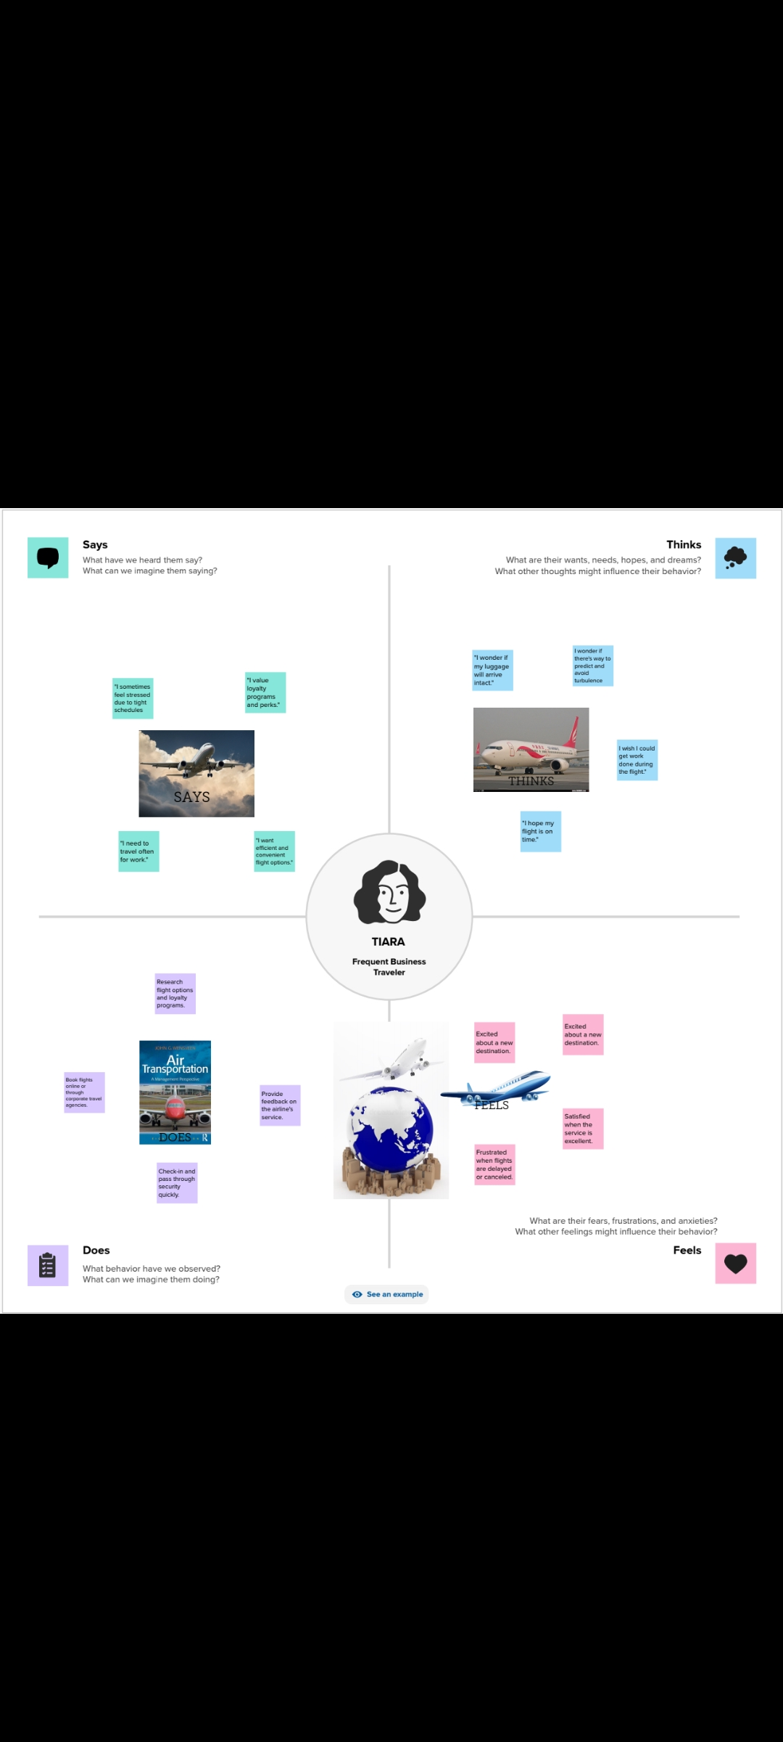

Slide 8
BRAINSTORMING MAP

Slide 9


Slide 10
SHEETS

Slide 11
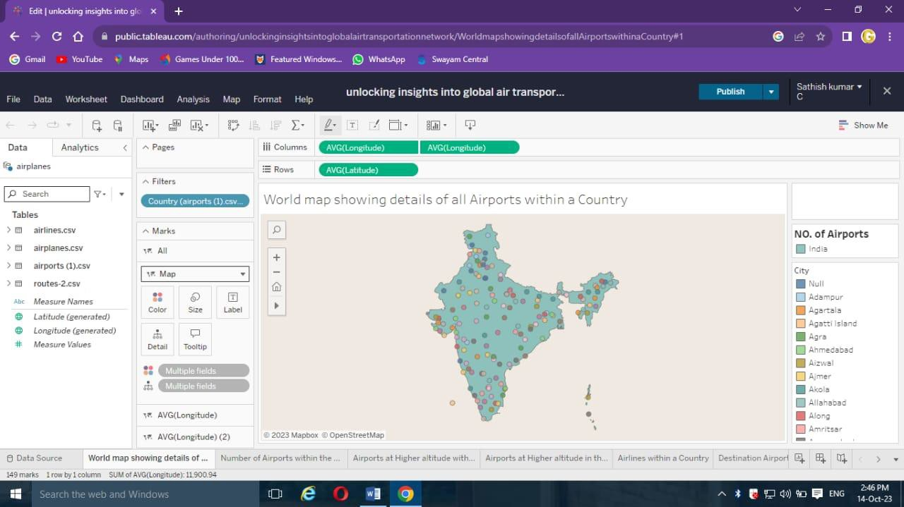

Slide 12
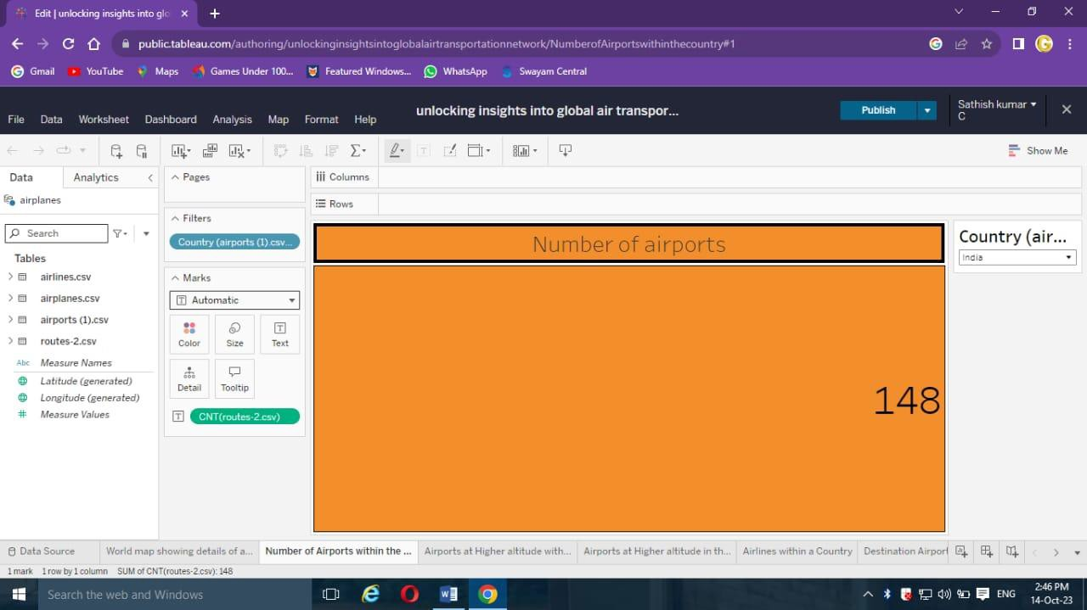

Slide 13
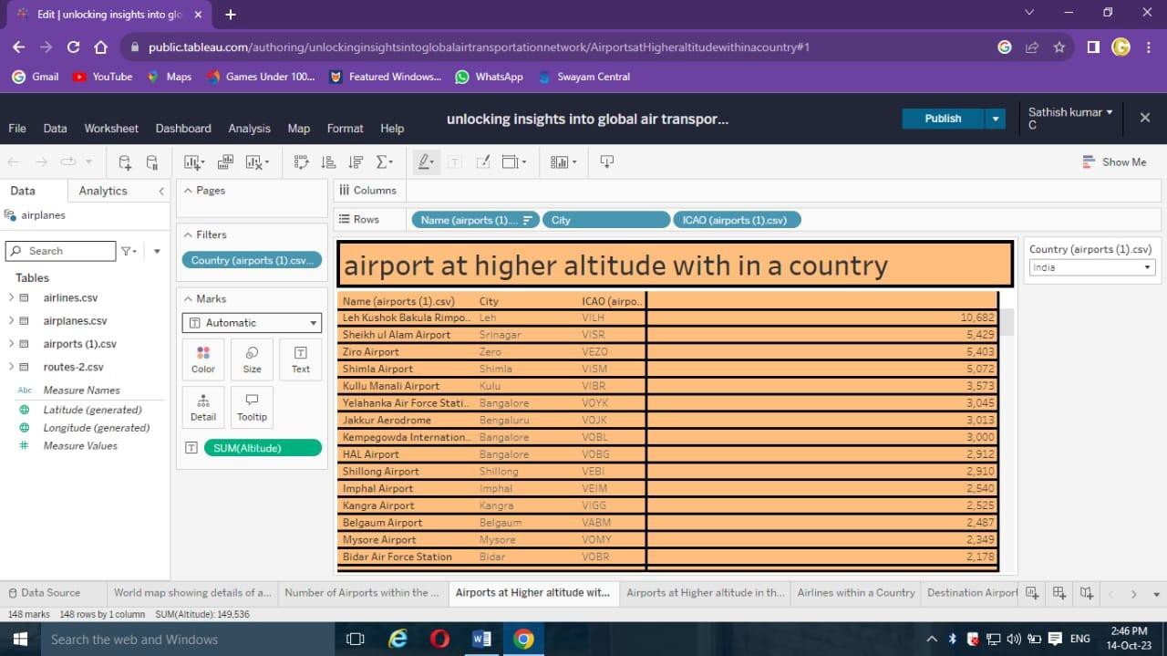

Slide 14
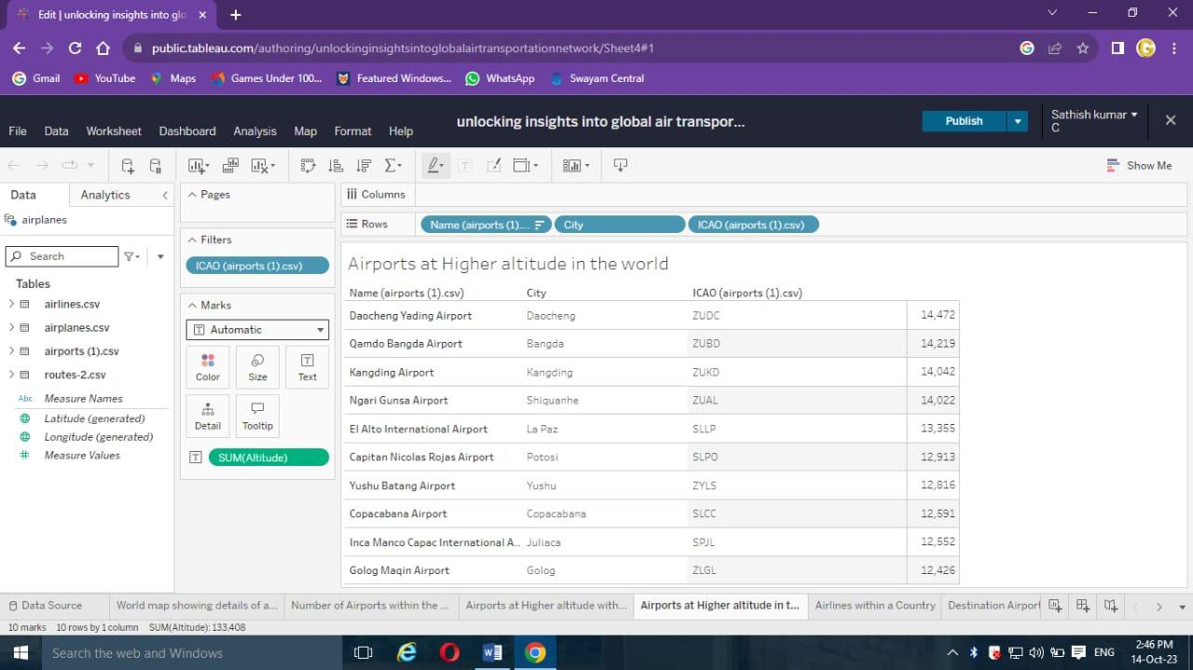

Slide 15
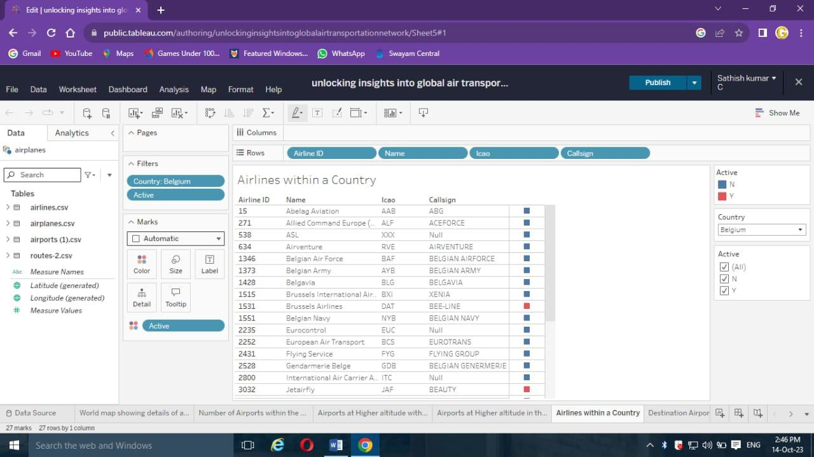

Slide 16
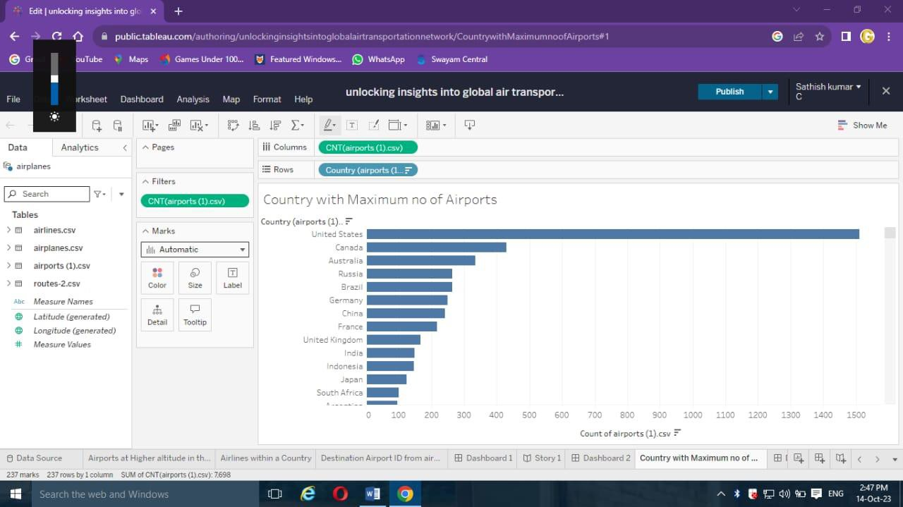

Slide 17
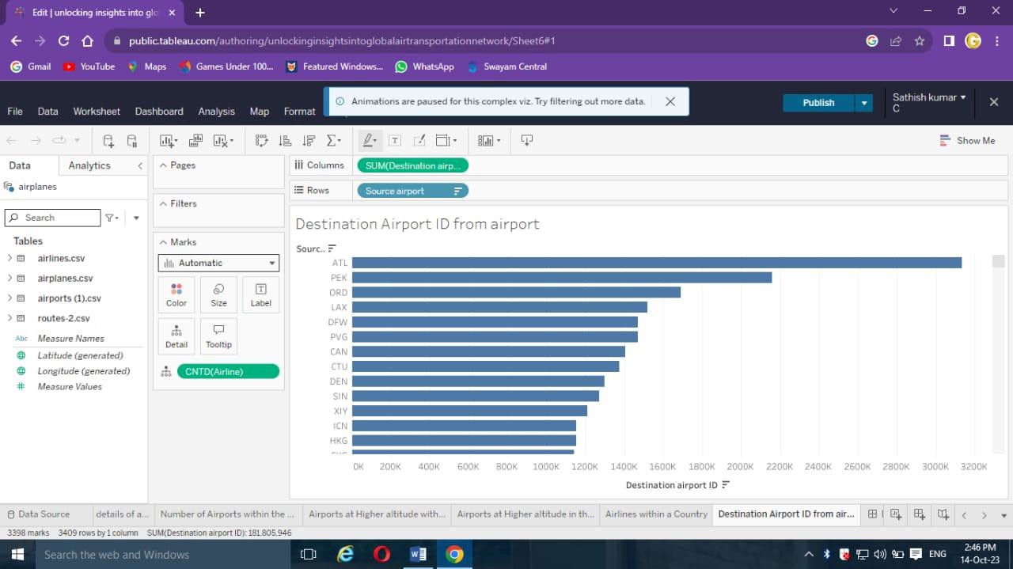

Slide 18
DASHBOARD

Slide 19
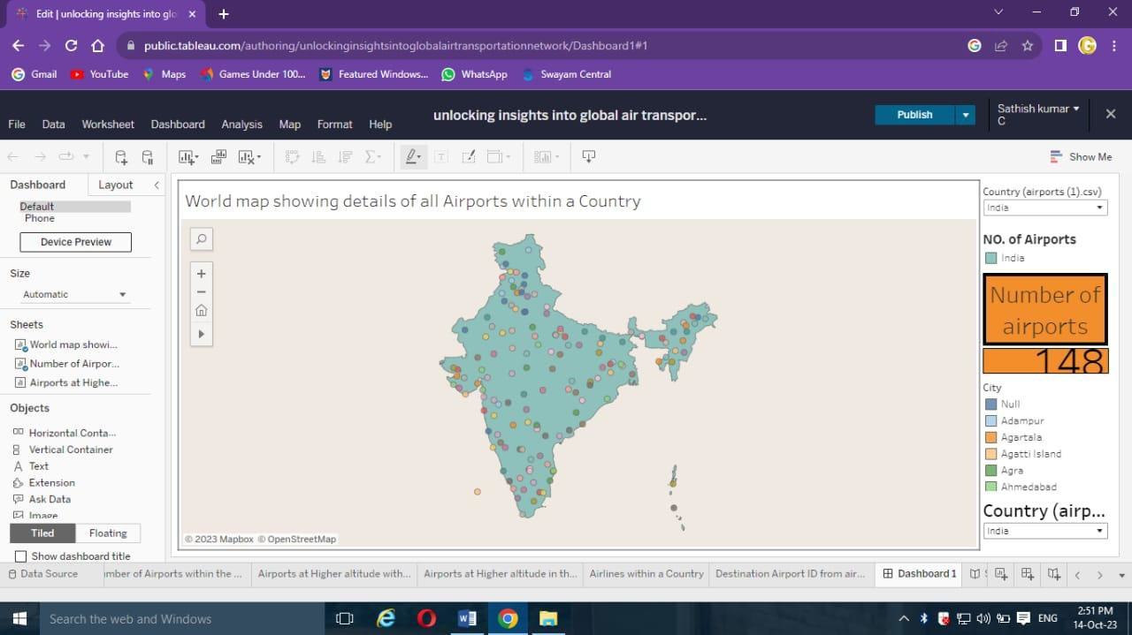

Slide 20
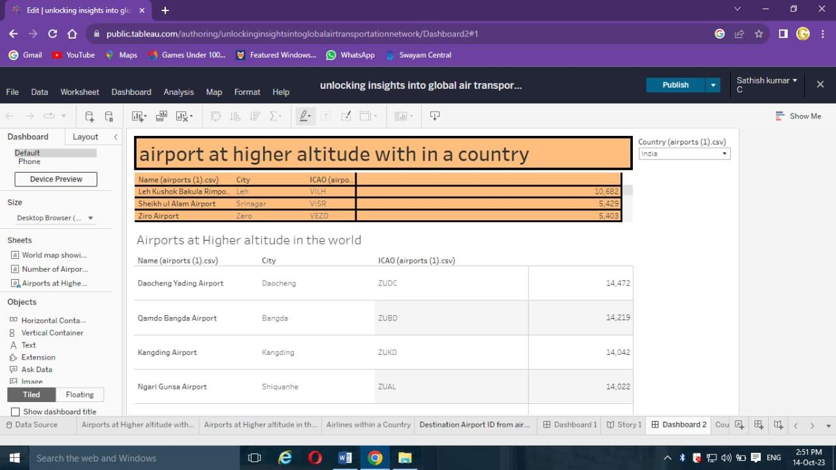

Slide 21
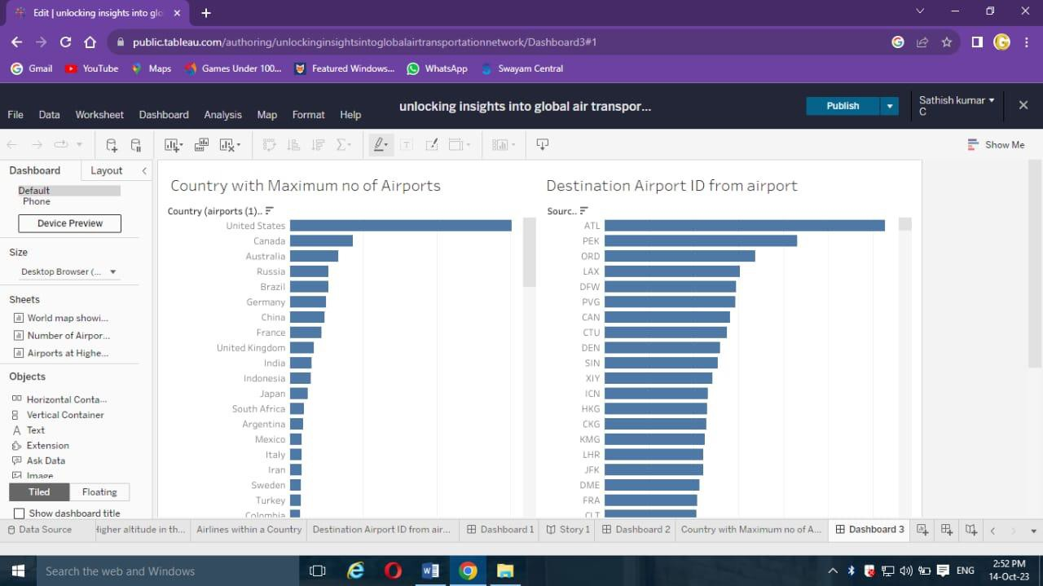

Slide 22
STORY

Slide 23
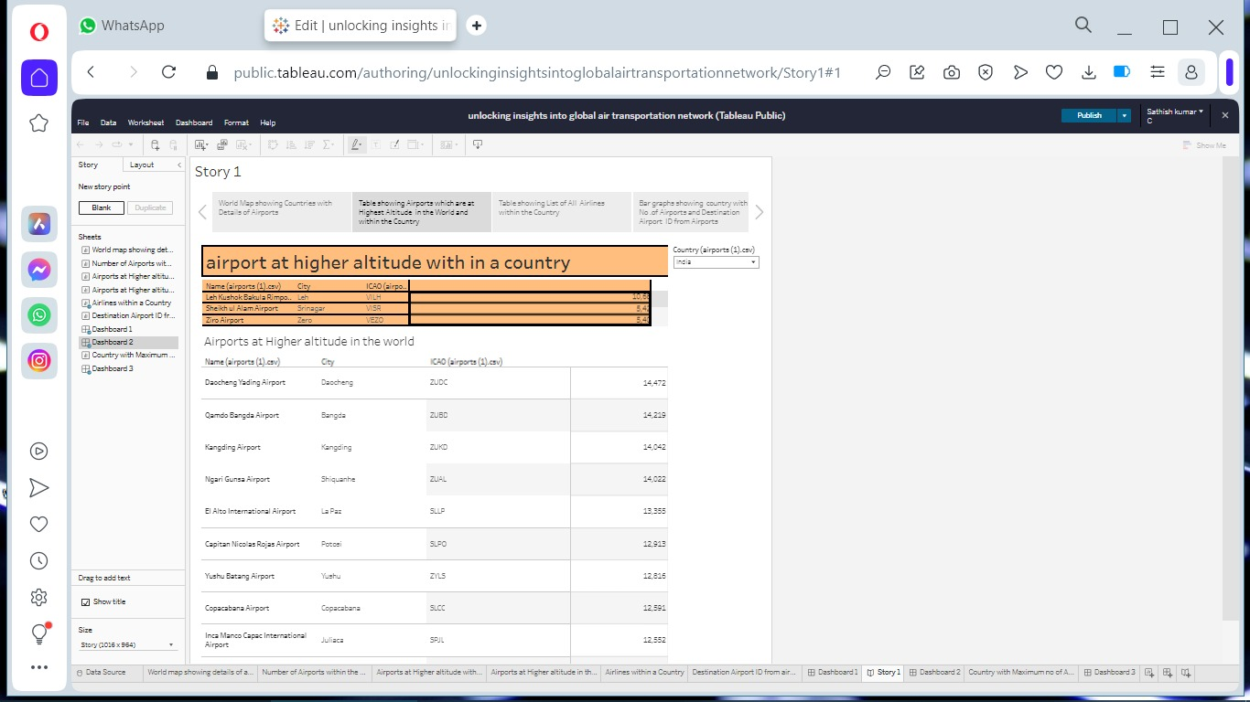

Slide 24
THE END

